Slide 1
درس اندازه گيري الکتريکي جلسه اول
محمد علي احمدي پژوه
زمستان 91

Slide 3
چرا اندازگيري؟
متغير مطلوب
مبدل
مدار بهسازي
تقويت كننده
ثبت كننده
داده پردازي
منبع تغذيه

Slide 4
چرا اندازگيري؟ (ادامه)
تحليل رفتار سيستمها
صنعتي
زيستي
پايش سيستمها
صنعتي
زيستي
خانگي

Slide 5
چرا اندازگيري؟ (ادامه)
توليد كنندة فرمان كنترلي
كنترل كننده
سيستم تحت کنترل
متغير مطلوب
تقويت كننده
مدار بهسازي
مبدل
منبع تغذيه

Slide 6
مثال
پروسه هاي شيميايي و صنعت نفت
رباتيک
حمل و نقل
صنعت برق و آب
مديريت شهري
هوافضا
سيگنالهاي حياتي

Slide 7
تقسيم بندي دستگاه هاي اندازگيري
روش اندازگيري:
مطلق
ثانويه
نشاندهنده
ثبات
انتگرال گير
مکانيزم اندازگيري:
اثر مغناطيسي
اثر الکترواستاتيکي
اقر الکترومغناطيسي الغايي
اثر حرارتي
اثر شيميايي
دقت:
دقيق
صنعتي

Slide 8
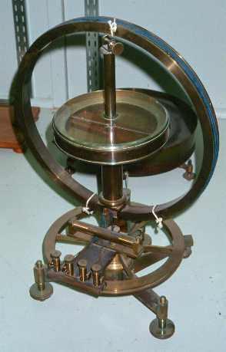
گالوانومتر
Notes:
The sine galvanometer, first described by Prof. Claude Pouillet of Paris in 1837, is a precursor of the tangent galvanometer. Like the tangent galvanometer, the sine galvanometer has a coil of wire carrying the current to be measured, and a magnetic compass needle in the middle of the coil. The coil of wire is first oriented in the magnetic north-south direction and the compass needle is acted on only by the horizontal component of the magnetic field of the earth.. The passage of the current sets up a magnetic field perpendicular to the coil, and the compass needle points in the direction of the total magnetic field. The coil is now rotated through an angle Ø until the plane of the coil coincides with the needle. Under these conditions, the two torques acting on the needle are due to (a) the magnetic field B of the coil, which is at right angles to the coil, and (b) the component of the earth's magnetic field perpendicular to the coil: B'sinØ. These two torques just balance each other. Since the value of B is proportional to the current I setting up this field, I is proportional to sinØ.
The advantage of this apparatus is that the needle does not have to lie in a uniform magnetic field, and so the compass needle can be relatively large.
This apparatus in the Garland Collection at Vanderbilt University was bought from Ruhmkorff of Paris about 1875.

Slide 9
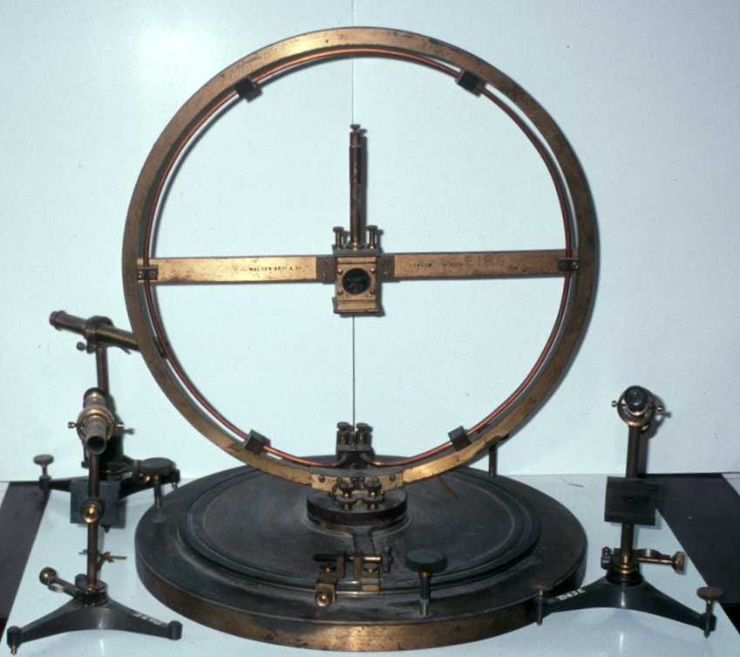
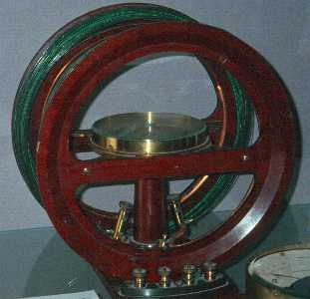
گالوانومتر (ادامه)
Notes:
The tangent galvanometer was first described in an 1837 paper by Claude-Servais-Mathias Pouillet (1790-1868), who later employed this sensitive form of galvanometer to verify Ohm's law. To use the galvanometer, it is first set up on a level surface and the coil aligned with the magnetic north-south direction. This means that the compass needle at the middle of the coil is parallel with the plane of the coil when it carries no current. The current to be measured is now sent through the coil, and produces a magnetic field, perpendicular to the plane of the coil, and directly proportional to the current. The magnitude of the magnetic field produced by the coil is B; the magnitude of the horizontal component the earth's magnetic field is B'. The compass needle aligns itself along the vector sum of B and B' after rotating through an angle Ø from its original orientation. The vector diagram shows that tan Ø = B/B'. Since the magnetic field of the earth is constant, and B depends directly on the current, the current is thus proportional to the tangent of the angle through which the needle has turned.
Fig Right-The Helmholtz-type tangent galvanometer at the left is in the collection of the University of Cincinnati. The small button in the middle of the coil reads "Elliott Bros/449/Strand/London.
Fig Left-The instrument at the left at the University of Vermont is by Nalder of London. It has a single winding for large currents and multiple windings for small currents. The telescopes are used for reading the direction of the compass needle.

Slide 10
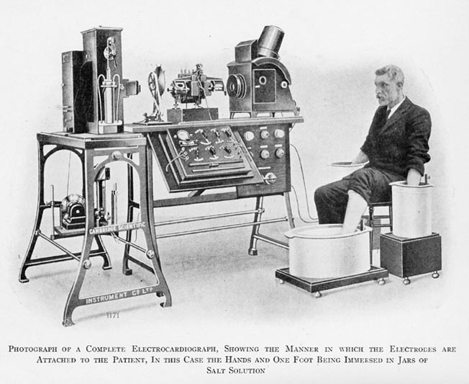
اولين دستگاه ثبت الکتروکارديوگرام
Notes:
Previous to the string galvanometer, scientists were using a machine called the capillary electrometer to measure the heart’s electrical activity, but this device was unable to produce results of a diagnostic level^{[2]}. Willem Einthoven invented the string galvanometer in the early 20th century, publishing the first registration of its use to record an electrocardiogram in aFestschrift book in 1902. The first human electrocardiogram was recorded in 1887, however it was not until 1901 that a quantifiable result was obtained from the string galvanometer ^{[3]}. He was awarded the Nobel prize in Physiology or Medicine in 1924 for his work.^{[4]}
How the string galvanometer works
Einthoven's invention consisted of a very long (several meters) silver-coatedquartz filament of negligible mass that conducted the electrical currents from the heart. This filament was acted upon by powerful electromagnetspositioned either side of it, which caused sideways displacement of the filament in proportion to the current carried due to the electromagnetic field. The movement in the filament was heavily magnified and projected through a thin slot onto a moving photographic plate ^{[1][5]}.
The filament was originally made by drawing out a filament of glass from a crucible of molten glass. To produce a sufficiently thin and long filament anarrow was fired across the room so that it dragged the filament from the molten glass. The filament so produced was then coated with silver to provide the conductive pathway for the current^{[6]}. By tightening or loosening the filament it is possible to very accurately regulate the sensitivity of the galvanometer^{[1]}.
The original machine required water cooling for the powerful electromagnets, required 5 operators^{[7]} and weighed some 600 lb.^{[5]}

Slide 11
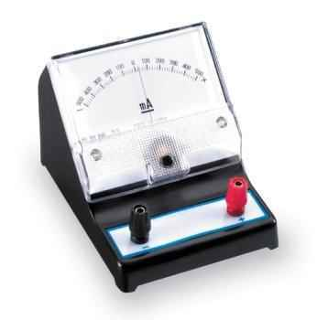
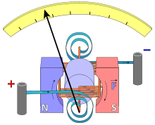
گالوانومتر (ادامه)

Slide 12
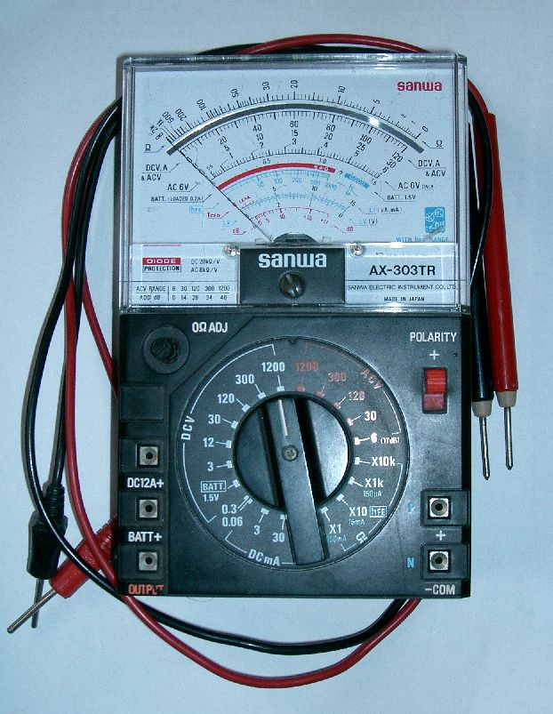
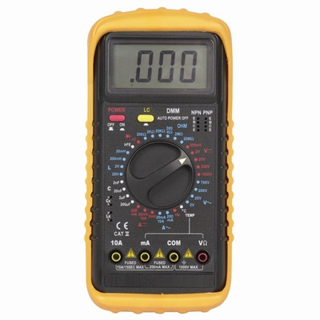
سنجش المانهاي الکتريکي

Slide 13
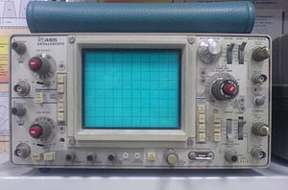
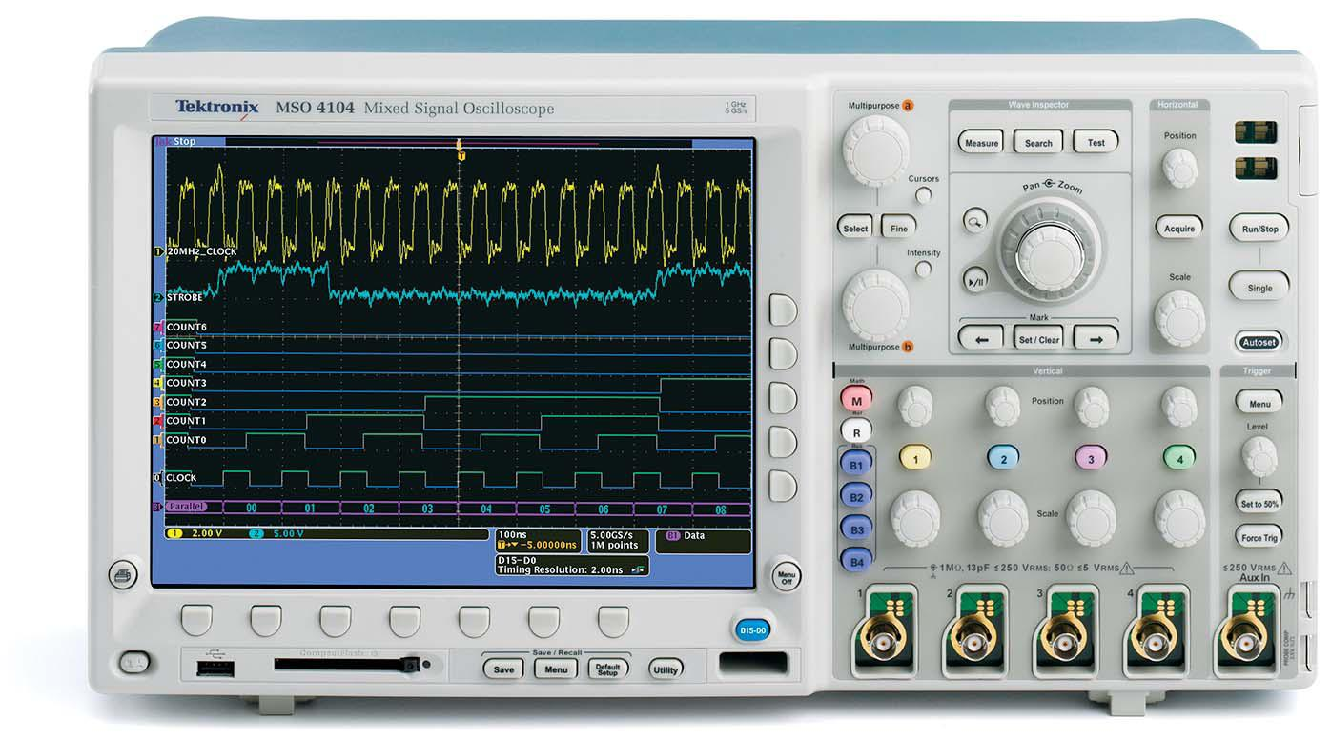
اسيلوسکوپ
Notes:
A Tektronix model 475A portable analog oscilloscope, a very typical instrument of the late 1970s

Slide 14
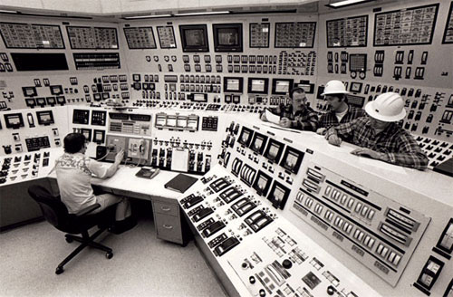
سيستم پايش آنالوگ

Slide 15
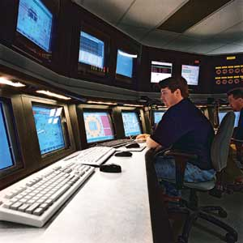
سيستم هاي پايش ديجيتال

Slide 16
روند ارائه مطالب
بخش اول:
اصول اندازگيري
خطا
مشخصه هاي سيستمهاي استاتيک و ديناميک سيستمهاي اندازگيري
دستگاه هاي اندازگيري آنالوگ
معرفي مکانيزمهاي توليد گشتاور
الکترومغناطيسي
الکترواستاتيکي
حرارتي
معرفي کاربرد مکانيزمهاي مختلف نمايش در
سنجش جريان، بار، شار، ولتاژ، توان، انرژي، فرکانس
بخش دوم:
روشهاي سنجش مقادير المانهاي الکتريکي توسط پلهاي مقاومتي
سنجش مقاومت
سنجش کاپاسيتانس
سنجش اندوکتانس
سيستمهاي اندازگيري الکترونيکي و اسيلوسکوپ
سيستمهاي اندازگيري الکتريکي
اسيلوسکوپ آنالوگ
اسيلوسکوپ ديجيتال

Slide 17
روند کلاس
ميان ترم: 40%
پايان ترم: 35%
تکاليف: 25%
شرکت در جلسه عملي آشنايي با اسيلوسکوپ: 5%
حضور بدون غيبت: 5%
مرجع اصلي درس:
جزوه اندازگيري الکتريکي، مهندس حسن ابوتراب
مرجع کمکي:
اندازگيري الکتريکي، اِي کِي ساوني، انتشارات نشر دانشگاهي

